Slide 1
Topic: Finance EQ: How do we account for income tax?
Year 11 Essentials

Slide 2
Things Required For This Lesson
Interactive Notebook
Textbook: Interleaved Maths Essential Connections
Ruler, Red Pen, Pencil, Pens, Scientific Calculator
Growth mindset

Slide 3
First 5
Answers
a)840:1260
b)350:1750
2. $64/hr
3.a) 18 b) 42
4. 51
Divide a money prize of $2100 between Tony and Adam in the ration: a) 2:3 b) 1:5
An electrician charged $160 for 21/2 hours work, what is the rate in $ per hr
Calculate the vale of 8x+2 when: a) x=2 b) x=5
What is 17% of 300?
How can you use formulas to compare costs?

Slide 4

24
7
30
Topic: Rates
Date: /03/2021
EQ: How are rates used for different units of measurement?
WICOR

Slide 5
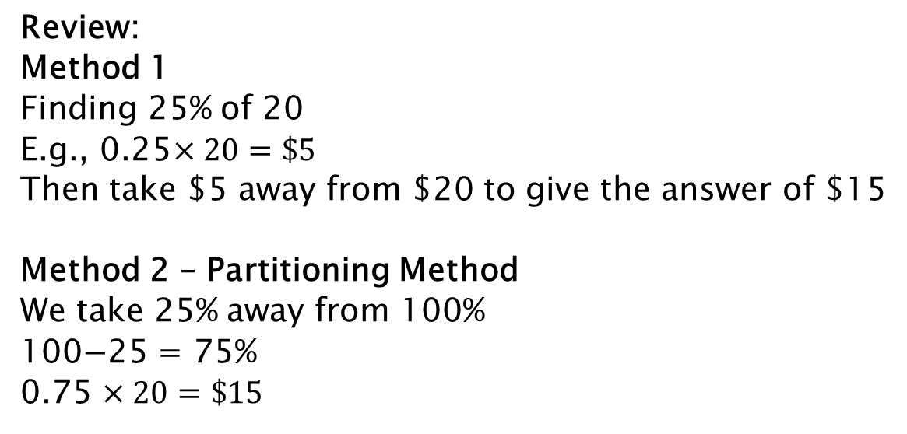
24
7
30
Topic: Finance
EQ: How do we account for income tax?
How to use the partitioning strategy for 25% off $20?
Review:
Method 1
Finding 25% of 20
E.g., 0.25$×20=\$5$
Then take $5 away from $20 to give the answer of $15
Method 2 – Partitioning Method
We take 25% away from 100%
100$−$25 = 75%
0.75 $×20=\$15$
WICOR

Slide 6
Practise
Complete practise set (table) on page 44 from your Interleaved Maths 11 book.

Slide 7
24
7
30
Topic: Finance
EQ: How do we account for income tax?
What is income tax?
Income tax is an money that is paid from our earnings to the government. In Australia our tax system is a progressive system – the more you earn, the greater the amount of tax you pay on those earnings.
It is calculated on your total income, even if it is from different sources.
WICOR

Slide 8
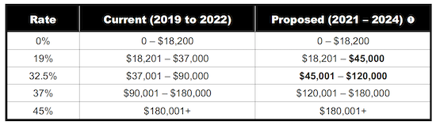
24
7
30
Topic: Finance
EQ: How do we account for income tax?
How is it determined?
Taxable income can be worked out using the different “brackets”.
e.g. Below $18000 income $0 tax payable
If I earned $19000 I would pay 19c per $1over that $18000. $19000-$18000 = $1000. Tax paid = $1000 x 0.19 = $190
WICOR

Slide 9
24
7
30
Topic: Finance
EQ: How do we account for income tax?
How can we work out how much is being paid?
To work out how much tax you need to pay, you need to break up your income into each of the tax brackets. Step 1: Split your pay into the different brackets
Step 2: Calculate the tax paid on the amount in each bracket at the different rates.
Step 3: Add the tax calculated to get the total for that year.
e.g. $43056 per year income = $5578.20 tax payable
Tax Brackets | 0-18k No tax | 18001-37k 19c per $1 | 37001-90k 32.5c per $1 | 180k+ 45c per $1
How much of my income is in this bracket? | 18000 | 19000 | 6056 | 0
Tax payable | 0 | 19000 x 0.19 =3610 | 6056 x 0.325 =1968.20 | 0
WICOR

Slide 10
Think pair share
Why might people have to pay a higher tax rate if they earn more?

Slide 11
Practice: (LSH)
Task
Mrs W earned $28000 per year in her day job and $13000 per year working night-fill. How much tax would she have to pay over the year?
How much tax would be taken out if someone was earning $147000 annually in 1 year?
Complete the investigate questions on Page 45

Slide 12

Thank you
Keep up the good work!
“You are braver than you believe, stronger than you seem and smarter than you think.”
-A.A Milne

